Slide 1

TEAM 6
INTELLIGENT FINANCIAL PLANNING HUB

Slide 2


INTRODUCTION
Personal Finance Tracker
A comprehensive web application for managing personal finances.
Key Features
User Registration & Login
Budget Management
Expense Tracking
Data Visualization
Transaction Management
Export

Slide 3


PROJECT OVERVIEW
THE PERSONAL FINANCE TRACKER IS A WEB-BASED APPLICATION DESIGNED TO HELP USERS MANAGE THEIR PERSONAL FINANCES EFFECTIVELY. IT ALLOWS USERS TO:
Register and Login:
Secure user registration with validation.
Login functionality with session management.
Set Budgets:
Allocate overall and category-wise budgets.
Provide real-time feedback on budget usage.
Track Transactions:
Add, edit, and delete transactions.
View transactions in a dynamic, paginated table.
Graphical Dashboard:
Display overall budget vs. expense data.
Show category-wise expense breakdown using charts.

Slide 4
PROJECT OVERVIEW
THE PERSONAL FINANCE TRACKER IS A WEB-BASED APPLICATION DESIGNED TO HELP USERS MANAGE THEIR PERSONAL FINANCES EFFECTIVELY. IT ALLOWS USERS TO:
Export Features:
Transaction Details can Be exported into PDF and Excel format.

Slide 5






TECH STACK
<frontend>
<backend>
HTML
FLASK
CSS
JavaScript
<Database>
SQLite

Slide 6


MILESTONE
1
2
User Authentication
Financial Reporting
Expense Management
3
4
Dashboard and Data Visualization
Budget Planning and Alerts

Slide 7


MILESTONE
1
User Authentication
Developed a secure and user-friendly authentication system with registration, login, logout, and dashboard display. Incorporated robust form validations and comprehensive test cases.
Expense Management
Built a dynamic expense tracking module with a well-structured database, user-friendly interfaces for adding, updating, and deleting expenses, and detailed expense views. Ensured reliability through form validations and test cases.

Slide 8
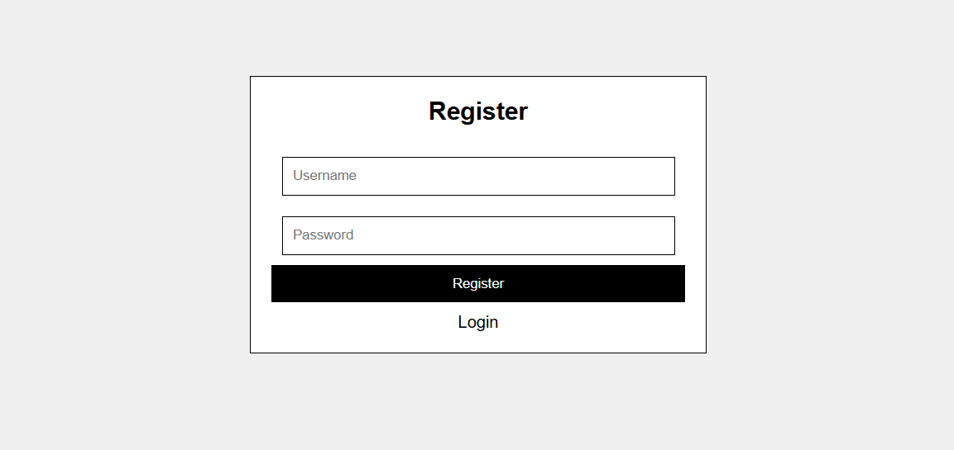
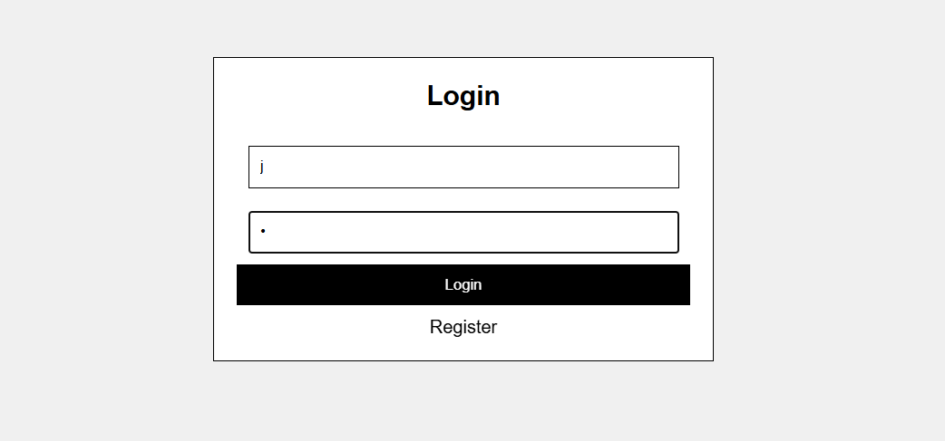
LOGIN/REGISTER

Slide 9
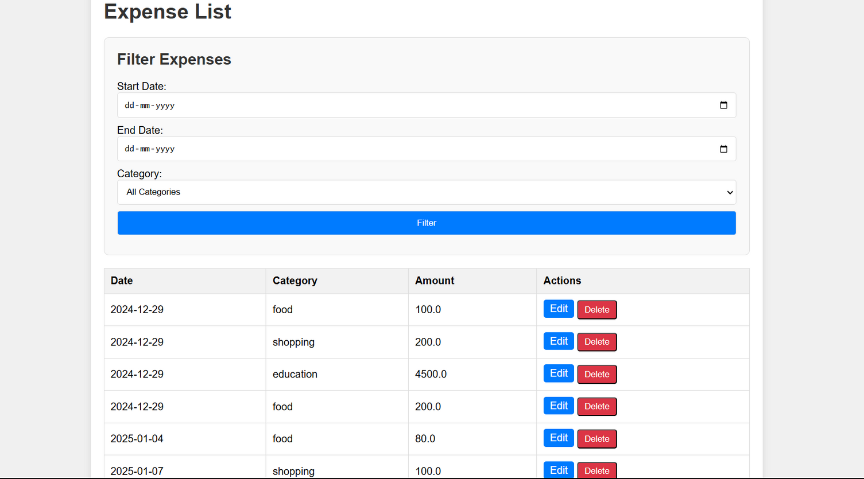
EXPENSE LIST

Slide 10
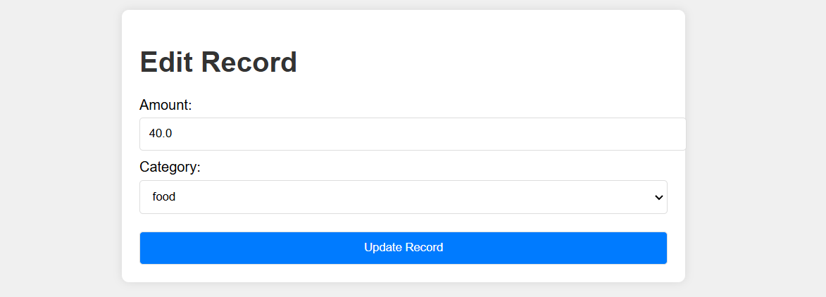
EDIT EXPENSE

Slide 11
MILESTONE
2
Financial Reporting
Designed a robust financial reporting module enabling users to generate reports for selected date ranges. Implemented backend logic for expense analysis, including totals and averages. Integrated data visualizations like charts and graphs to showcase spending patterns. Added export-to-PDF functionality, ensured form validations, and wrote test cases for all reporting features.

Slide 12
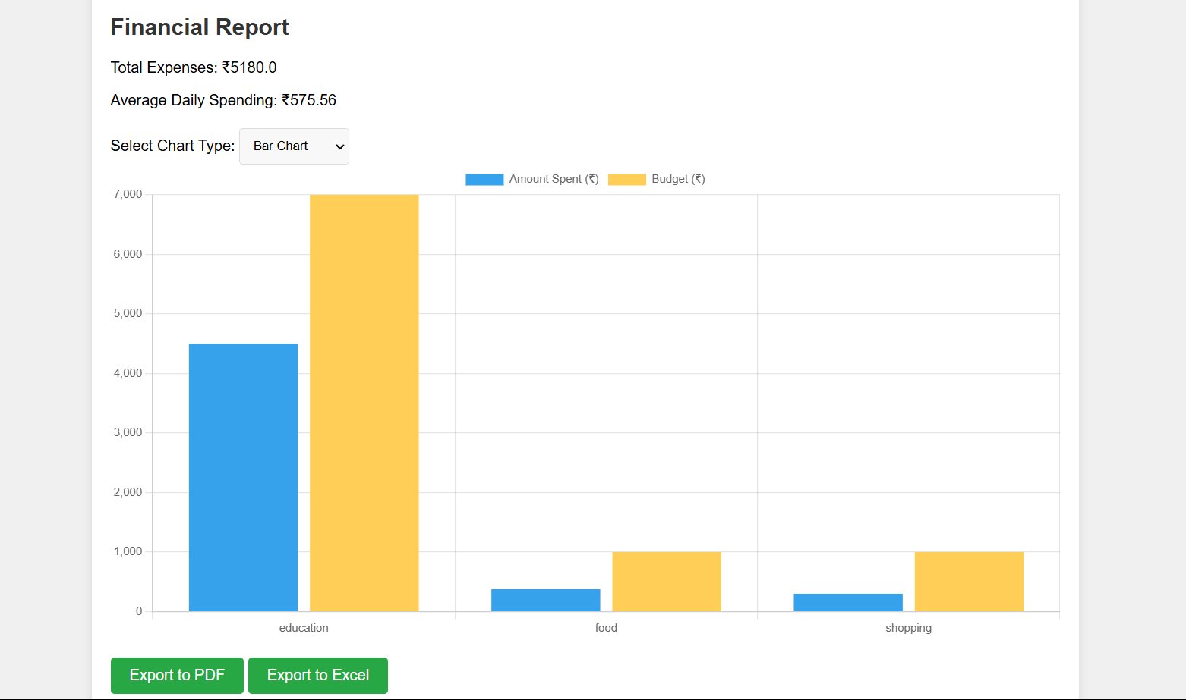
FINANCIAL REPORT

Slide 13
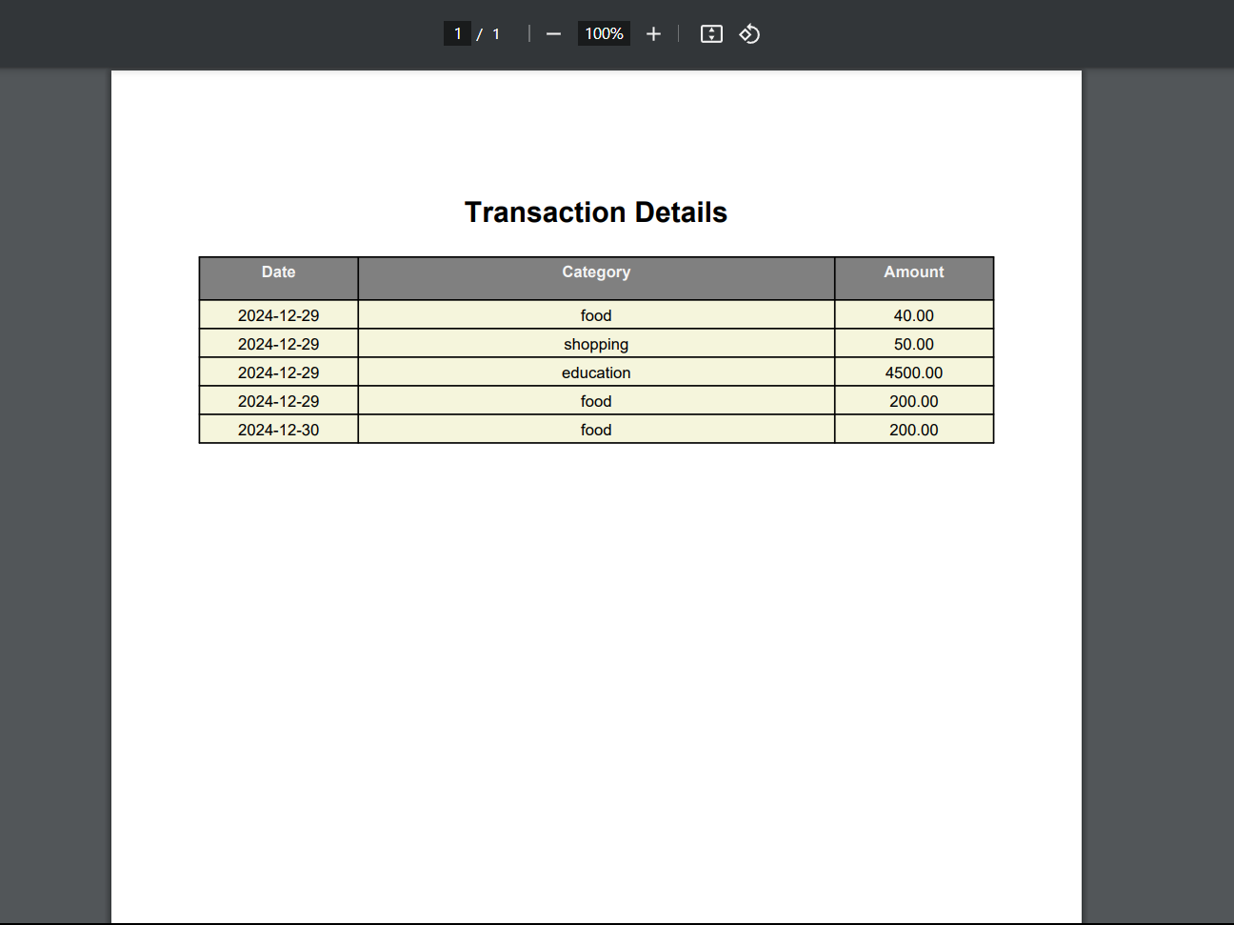
EXPORT TO PDF

Slide 14
MILESTONE
3
Dashboard and Data Visualization
Developed an interactive user dashboard displaying key financial metrics and real-time updates. Created dynamic charts and graphs for visualizing spending trends. Added filters to view expenses by category or date range. Introduced budget tracking with visual indicators for overspending. Ensured responsive design across devices and implemented comprehensive test cases for all dashboard components.

Slide 15
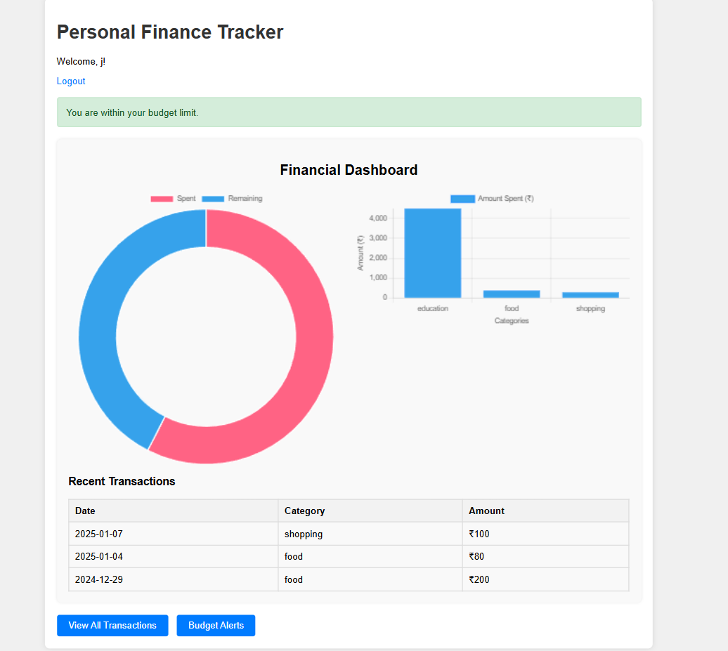
FINANCIAL DASHBOARD

Slide 16
MILESTONE
4
Budget Planning and Alerts
Implemented features for users to set budget limits per category, with alerts for approaching or exceeding limits. Added a budget vs. actual spending comparison and financial goal-setting with progress tracking. Ensured robust error handling, user feedback, and thorough test cases for all budget-related functionalities.

Slide 17
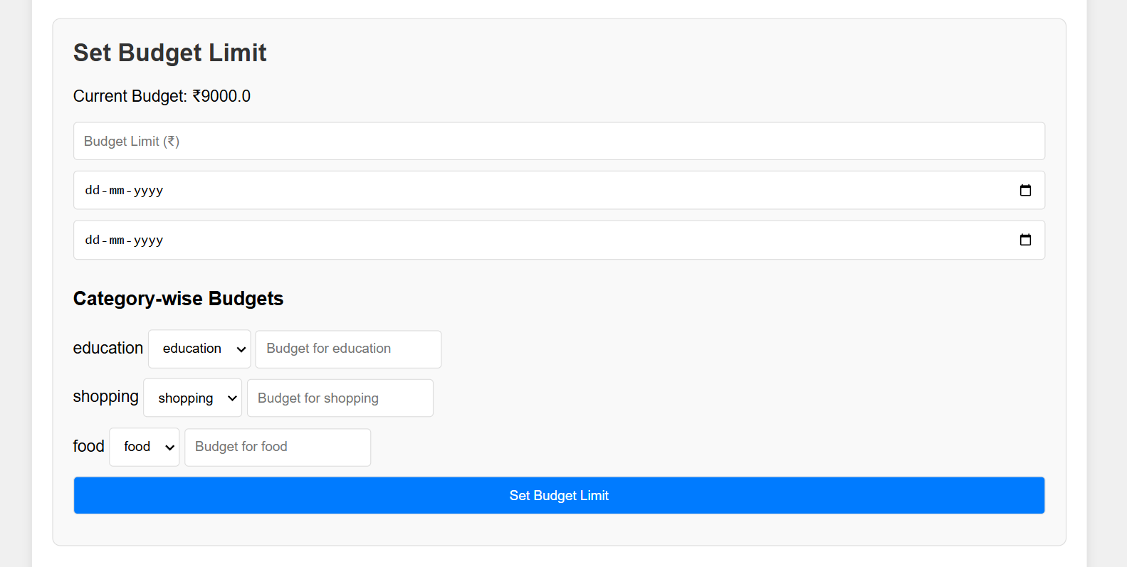
BUDGET PLANNING

Slide 18
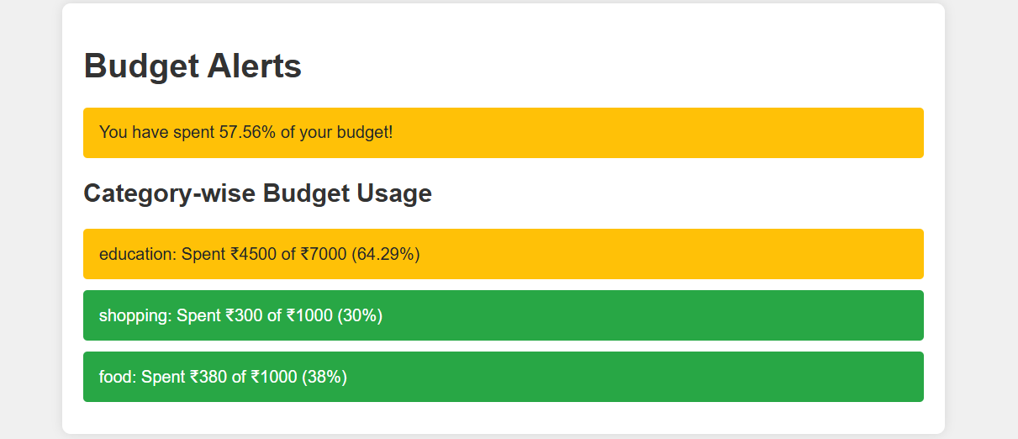
ALERTS

Slide 19











SYSTEM ARCHITECTURE
USER
REGISTRATION
LOGIN
DASHBOARD
FINANCIAL DASHBOARD
VIEW TRANSACTIONS
BUDGET ALERTS
EXPENSE LIST
ADD EXPENSE
SET BUDGET
DATA VISUALIZATION
EXPORT
Contents:
Contents:
Contents:
Contents:
Contents:
DATE
CATEGORY
AMOUNT
ACTIONS
CATEGORY
AMOUNT
OVERALL BUDGET
TIME PERIOD OF BUDGET
CATEGORY WISE BUDGET
FINANCIAL REPORT
EXPORT TO PDF
EXPORT TO EXCEL
EDIT
DELETE

Slide 20

CONCLUSION
The Personal Finance Tracker application is a comprehensive tool for managing personal finances, offering features like secure authentication, expense tracking, budget planning, and interactive dashboards. It ensures user-friendly navigation, real-time updates, and insightful financial analytics, enabling better financial habits and goal achievement efficiently.

Slide 21

TEAM
Jayanth Sai Vanapalli

Slide 22
THANK YOU

